Slide 1
Source Code Sample and Github Link
Tech Selector
TEAM 1
RELEASE 2 (I3,I4)

Slide 2
GitHub Link
Here is the github link of the project
https://github.com/ajaygpt303/Techselector

Slide 3
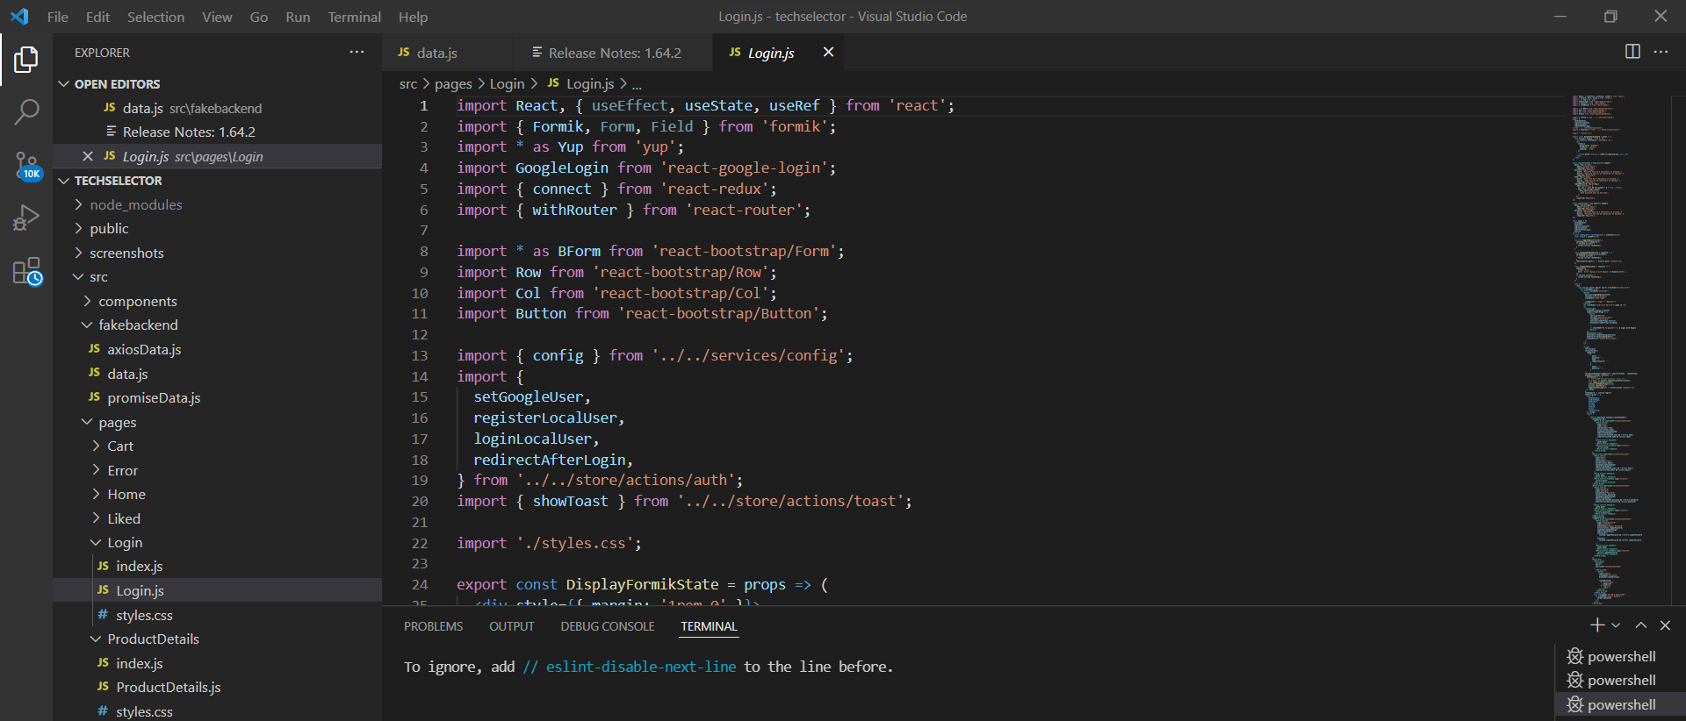
Github code screenshot and code samples

Slide 4
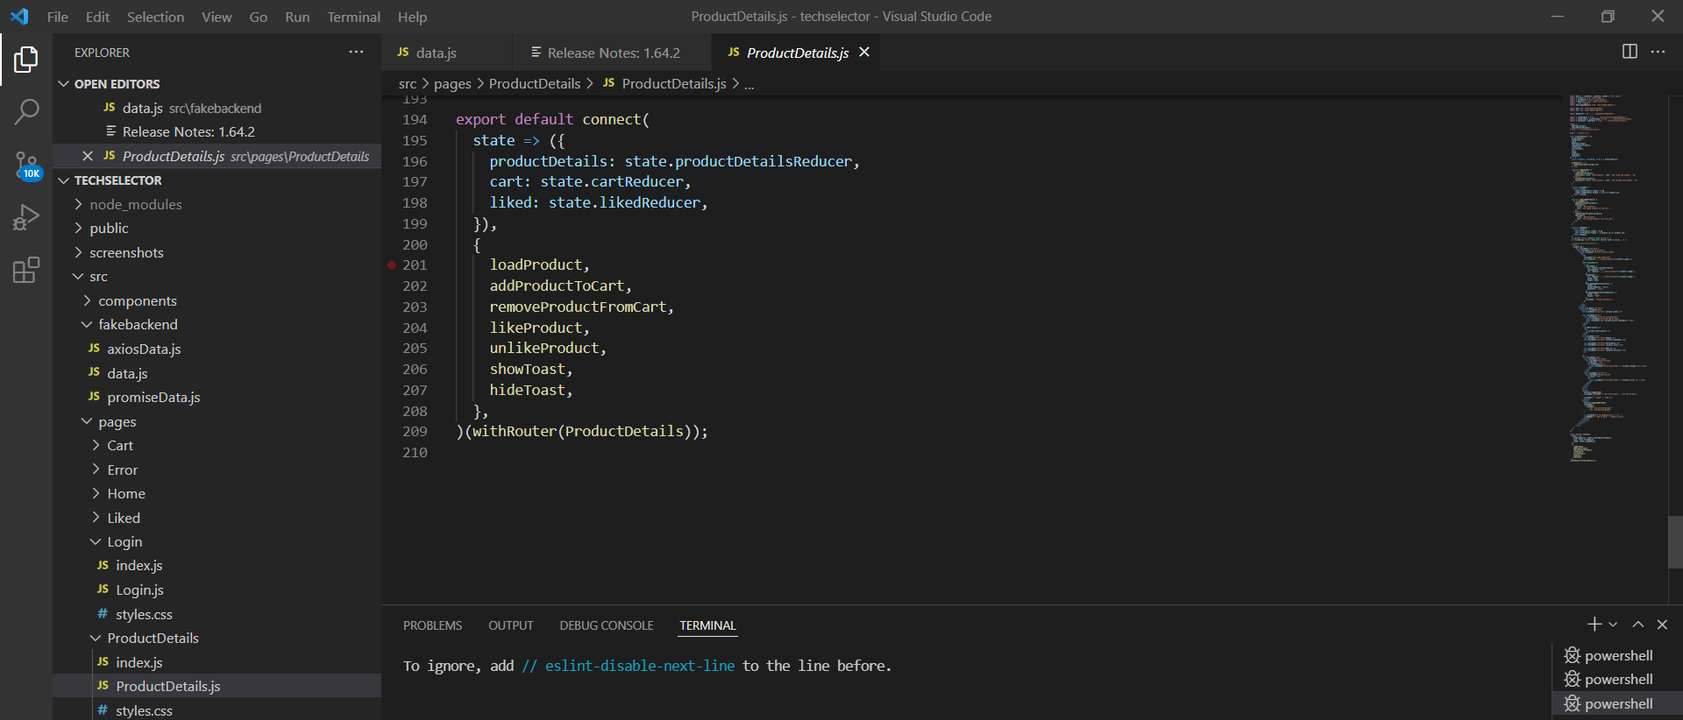

Slide 5
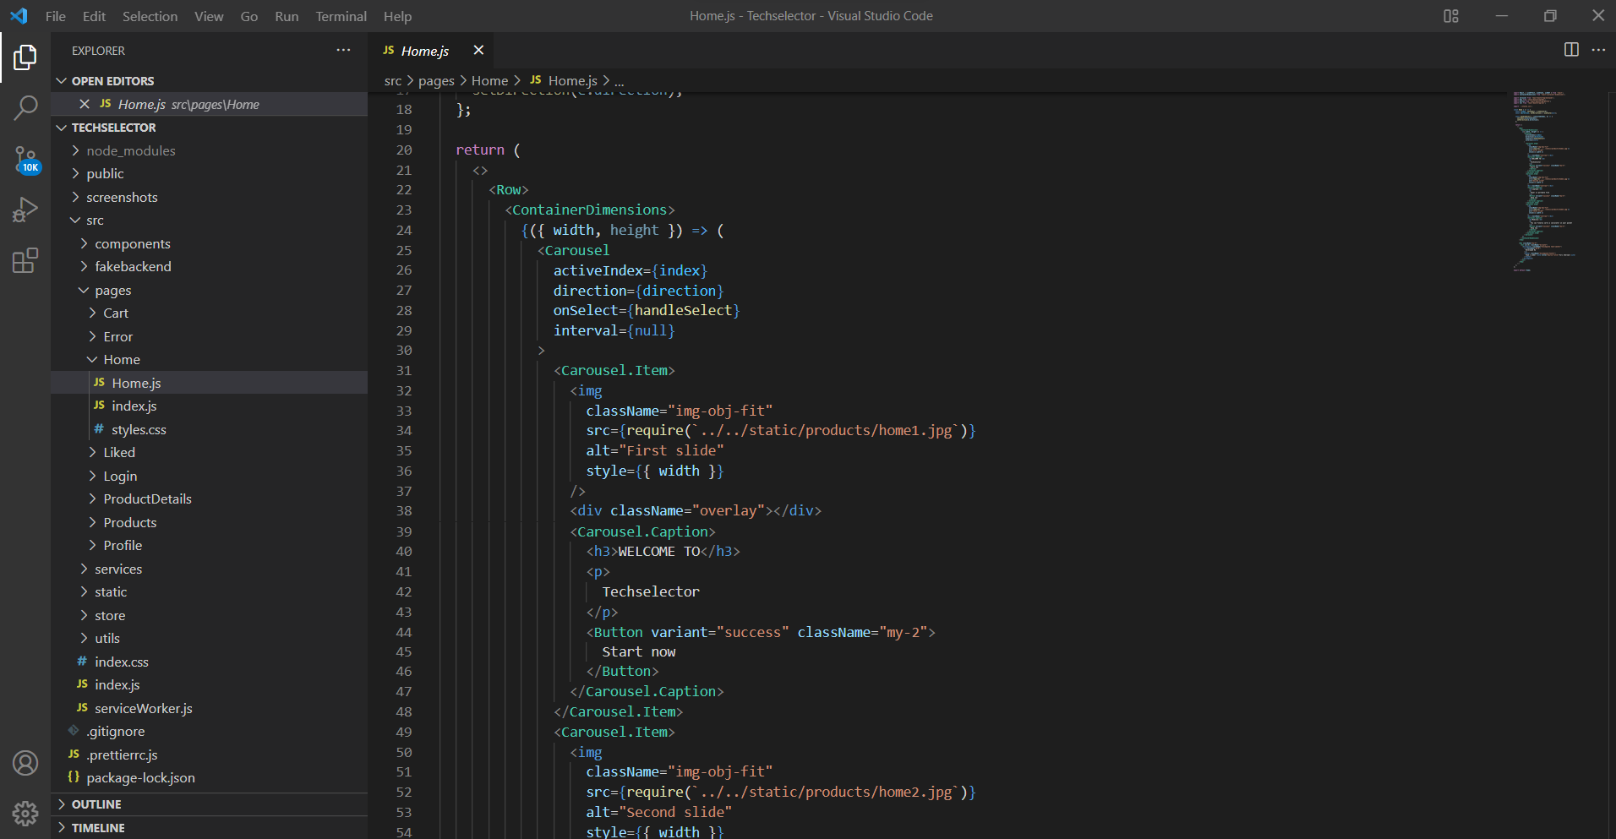

Slide 6
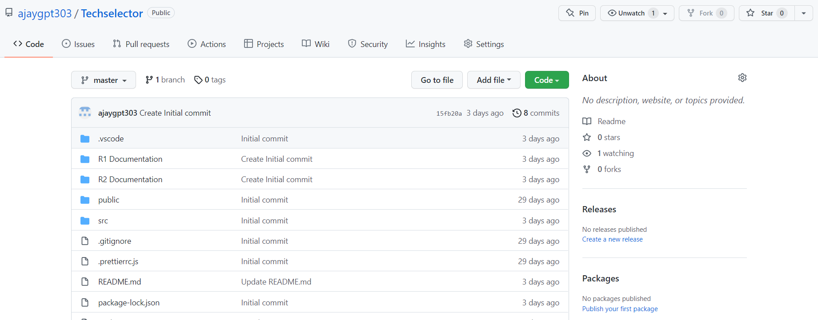

Slide 7
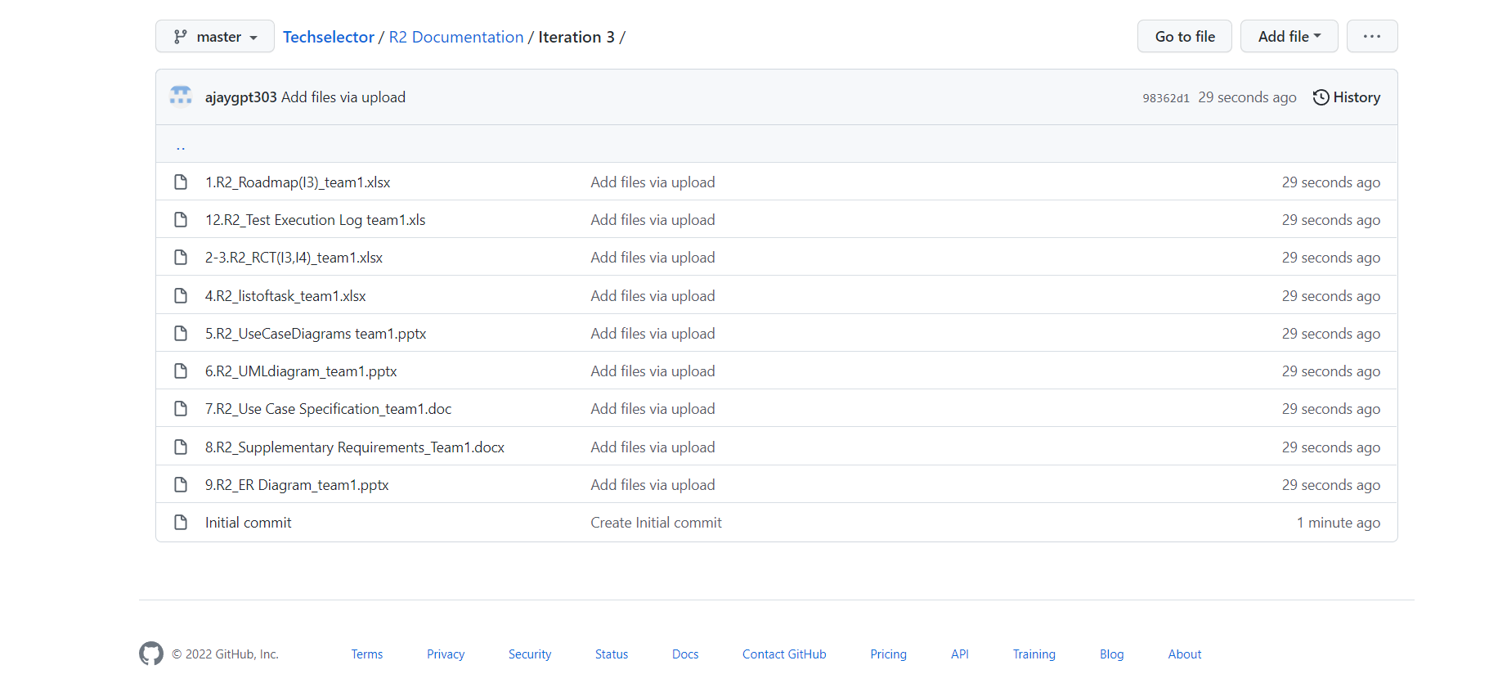

Slide 8
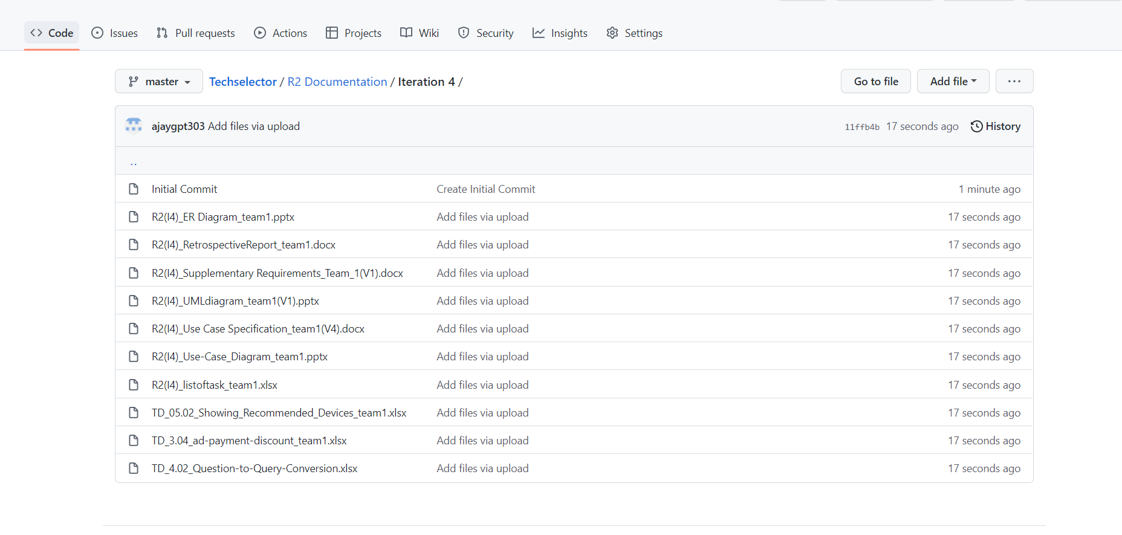

Slide 9
